Slide 1
Fuel Efficiency

Slide 2
Background
Fuel efficiency: how far a vehicle can travel per unit of fuel
“Miles per gallon”
Fuel efficient vehicles require less gas to go a given distance

Slide 3
Hypothesis
Which features and are most correlated with predicting fuel efficiency?
Concerns with city-cycle fuel consumption

Slide 4
Data Attributes
Mpg
Cylinders
Displacement
Horsepower
Weight
Acceleration
Model
Origin

Slide 5
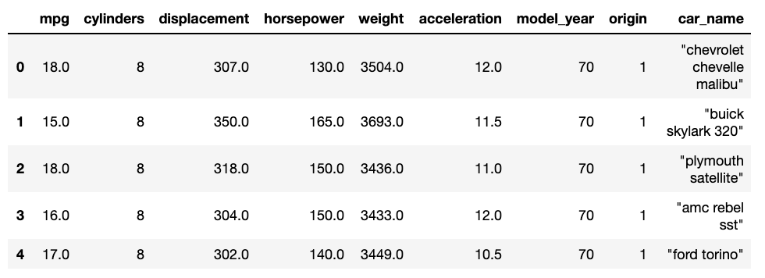
Data

Slide 6


Data Ingestion
Data Ingestion
Input Data
UCI Repository
Auto MPG Data set
Notes:
Auto MPG Data Set

Slide 7
Data Wrangling
Removed values that had a “?” from the Horsepower column
Remove car name—unique to each row; not good for prediction

Slide 8
Exploratory Analysis

Slide 9
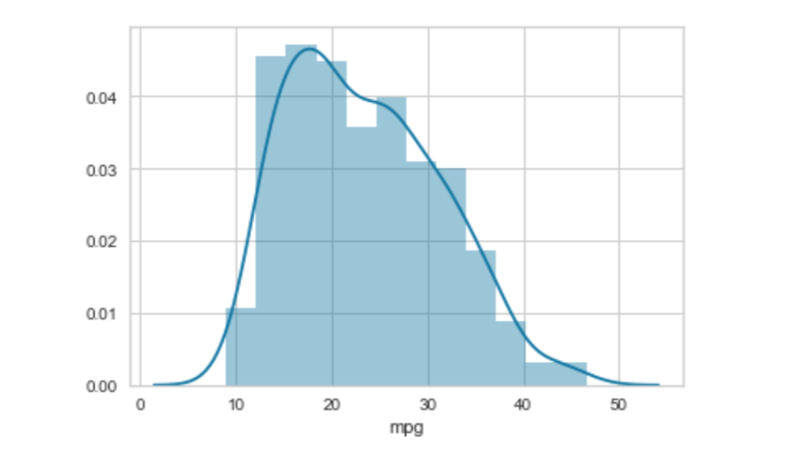
Exploratory Analysis
Distribution of mpg (fuel efficiency)
Notes:
-Normal Distribution

Slide 10
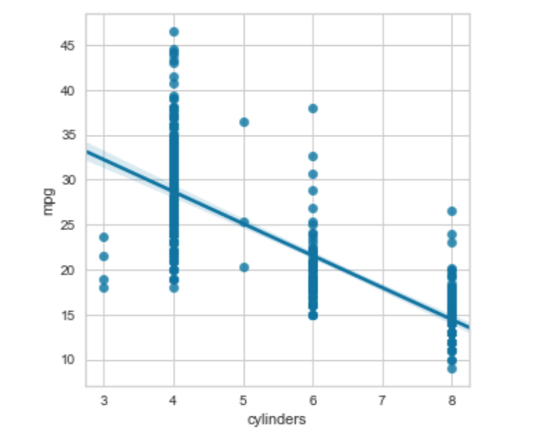
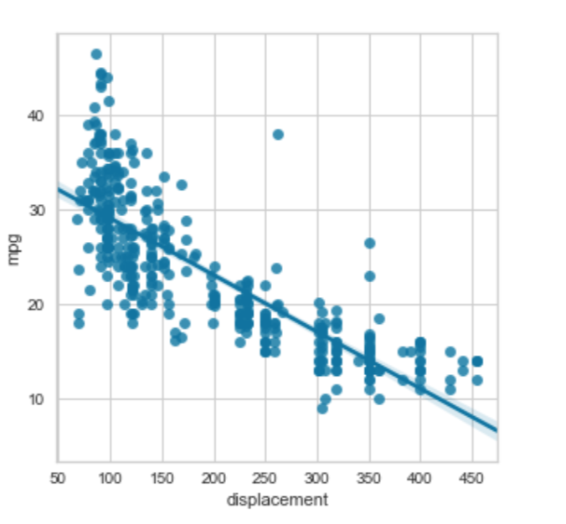
Exploratory Analysis
Mpg~ cylinders Mpg~ displacement
Notes:
-Negative linear relationship: Displacement
-More of a pattern than with the cylinders

Slide 11
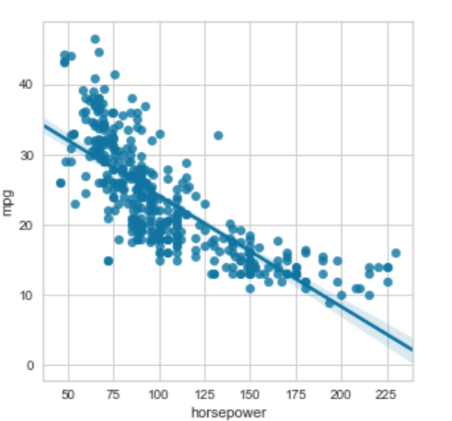
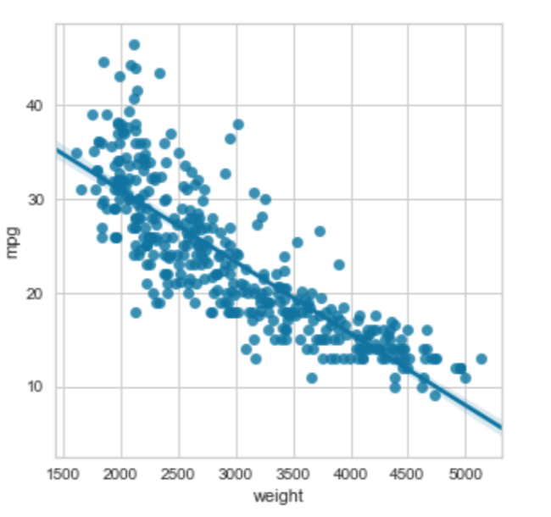
Exploratory Analysis
Mpg~ horsepower
Mpg ~ weight
Notes:
-Horsepower and weight negative linear relationship

Slide 12
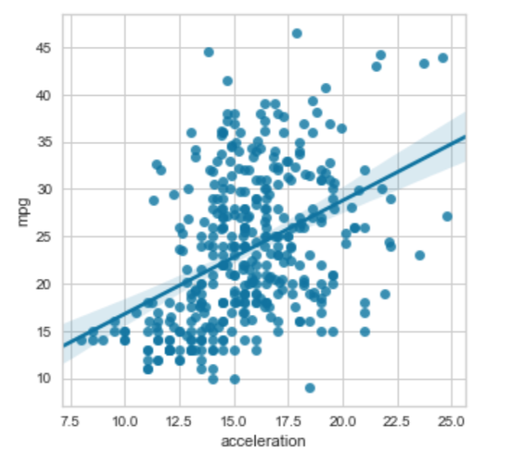
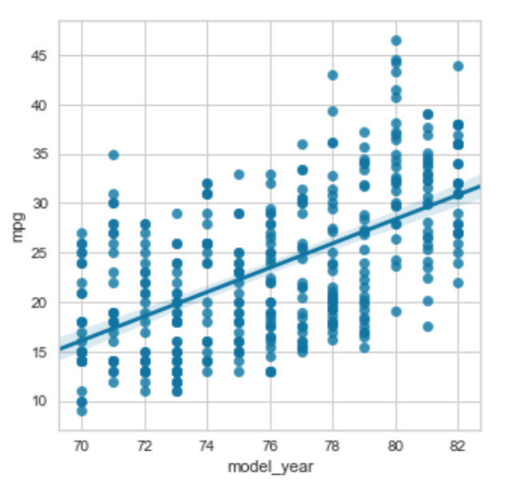
Exploratory Analysis
Mpg ~ acceleration
Mpg ~ model-year
Notes:
-Acceleration:

Slide 13
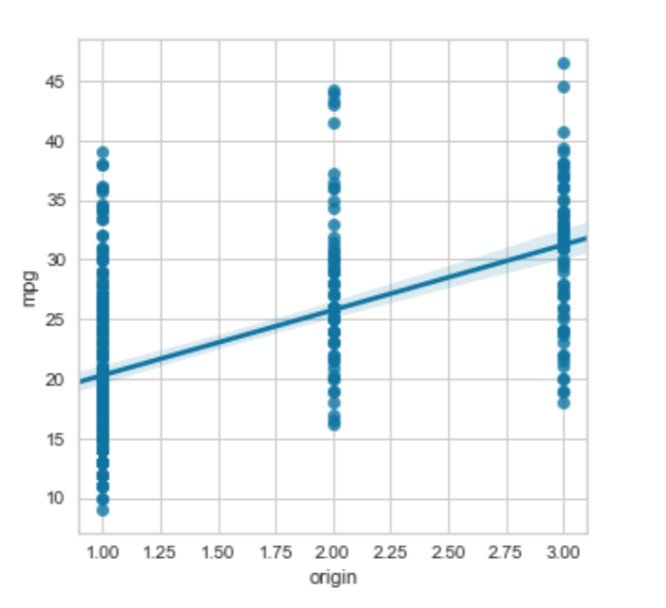
Exploratory Analysis
Mpg~ origin
Notes:
-Positive relationship

Slide 14
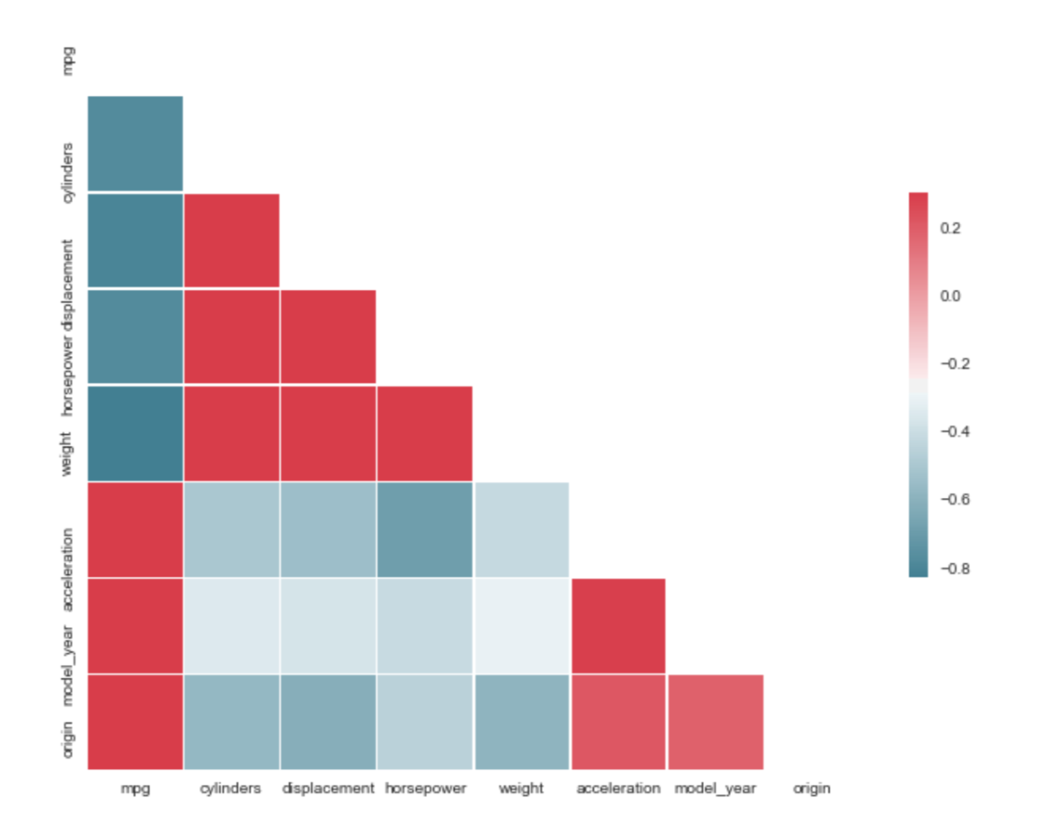
Correlation
Notes:
-Commensurate with our regression graphs previously noted

Slide 15
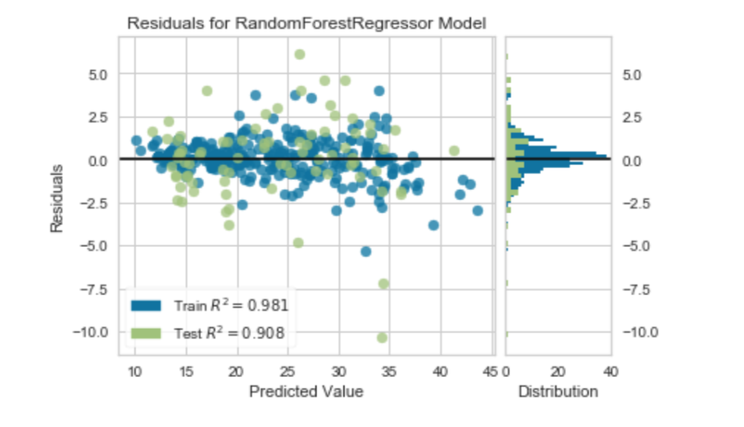
Model Training, Selection & Analysis
Random Forest Regressor score = 0.9081
Residuals:

Slide 16
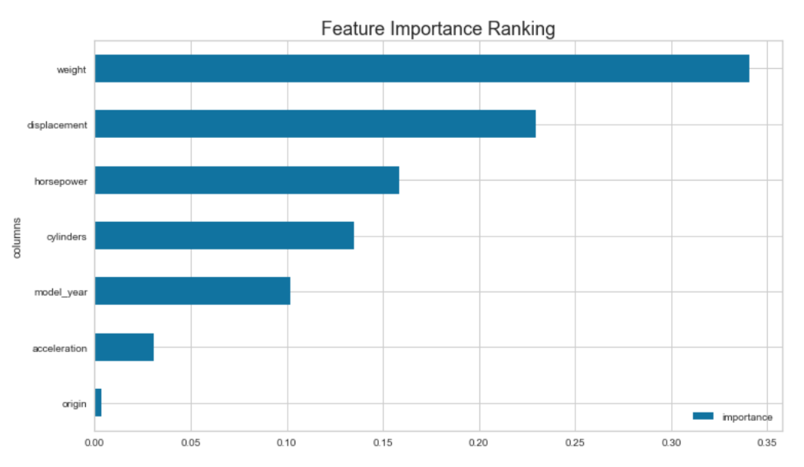
Feature Importance Ranking
Weight, displacement, horsepower, cylinders

Slide 17
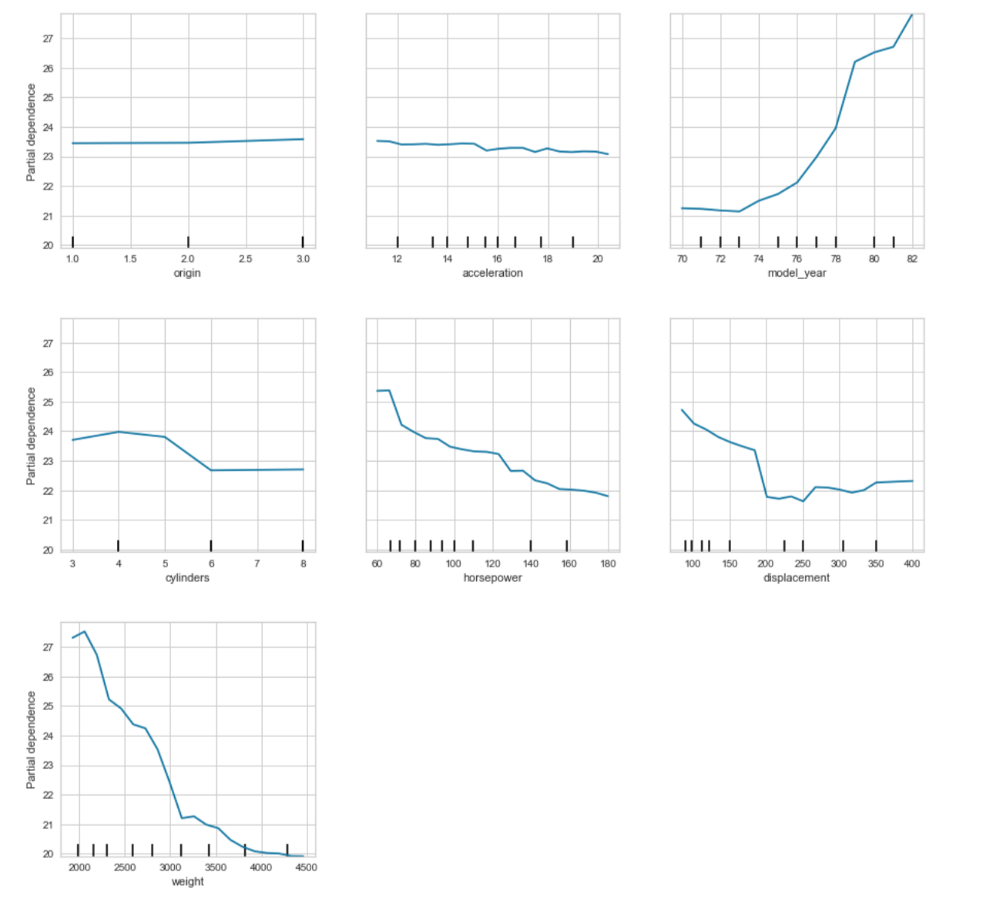
Partial Dependence on top features

Slide 18
Link to github repository
https://github.com/georgetown-analytics/XBUS-507-01.Applied_Data_Science/tree/master/ADS-Summer2019/car_mpg

